Slide 1
Ecosystem Services Assessment Tool (ESAT) Interface Design – revision 4
By Shawn
August 19, 2019

Slide 2
General public login page

Slide 3
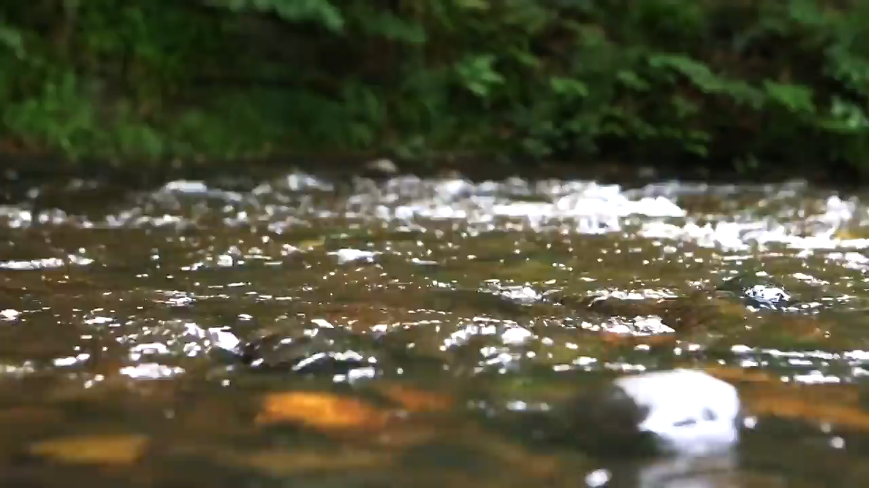
ESAT logo
Sign in to ESAT
User click here to login if they already have an account
All user sign from the same page
Email address
Password
Sign in
When user get an activation code, they can activate account from this link
Activate account
Forget password?
Contact admin
Click this button to contact admin (next slide)

Slide 4
ESAT logo
Contact Us
Name *
Email address *
Message
Send Message
Notes:
Contact admin page

Slide 5
ESAT logo
Message sent
X
Your message has been sent to ESAT team.
We will respond as soon as possible.
Contact Us
Name *
Dismiss
Email address *
Message
Send Message
Notes:
Confirm message sent

Slide 6

ESAT logo
Validation code
Legend
Map | Satellite
X
Please input your 6 digit validation code:
X
Together we save our planet
123456
Submit
User profile
First name
Last name
Date of birth
This 6 digit activation code will be linked to the user account which has been created by the administrator
Address
City
State/Province
Country
Account login
X
E-mail *
X
Password *
X
Confirm password *
N
Check here to confirm your profile and login information
+
−
Confirm
Notes:
Farm user register page – submit application

Slide 7
ESAT logo
In this page, user will verify his/her user profile and assigned parcel(s).
If there is some error, user can click “Report Error” to send to the admin
If no error, user will input the login email and password, then check the confirm checkbox and click “Confirm” to finish activation.
Legend
Map | Satellite
Together we save our planet
User profile
First name
Last name
Date of birth
User is NOT allowed to change assigned parcel in the map
Address
City
State/Province
Country
Account login
X
E-mail *
X
Password *
X
Confirm password *
N
Check here to confirm your profile and login information
Click to trigger contact us
+
−
Confirm
Report Error
Notes:
Farm user register page – submit application

Slide 8
ESAT logo
Legend
Map | Satellite
Congratulations!
X
Together we save our planet
Your registration to ESAT is complete!
User profile
Dismiss
First name
Last name
Date of birth
Address
City
State/Province
Country
Account login
X
E-mail *
X
Password *
X
Confirm password *
N
Check here to confirm your profile and login information
+
−
Confirm
Report Error
Notes:
Farm user register page – submit application

Slide 9
Admin user version
Admin will manage producer and manager accounts, and manage watershed simulation results

Slide 10




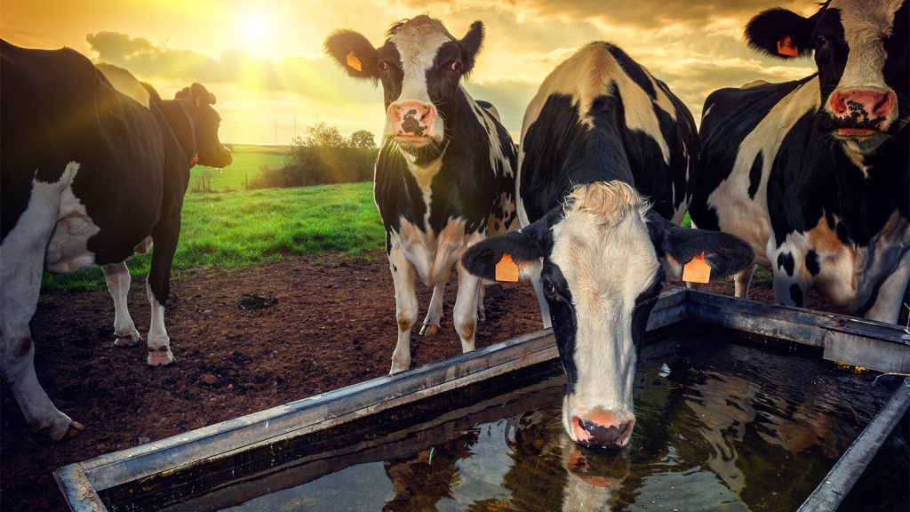
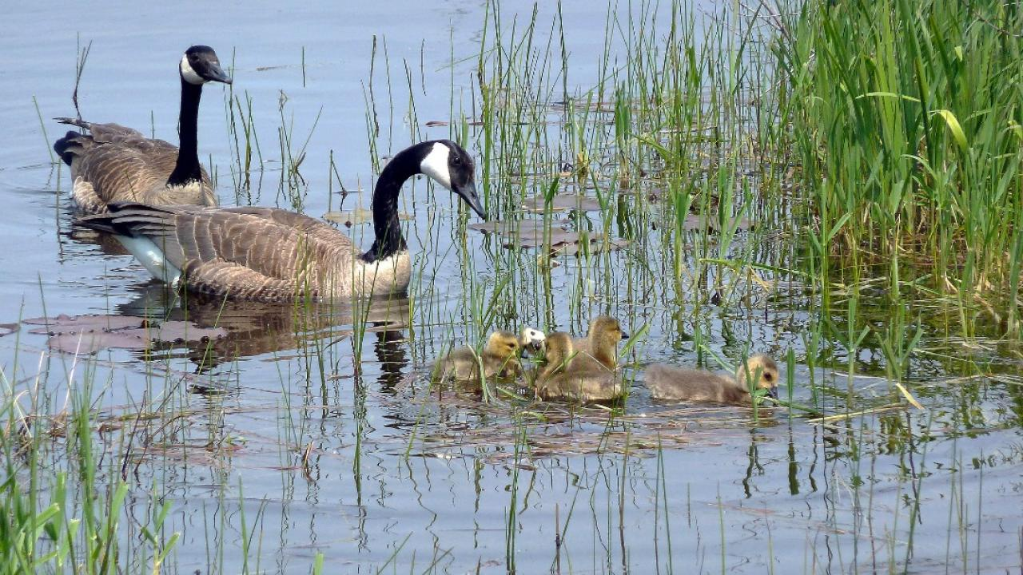

Logo
University of Guelph ESAT
Overview
shawn-uog@email.ca (admin)
UNIVERSITY OF GUELPH
<<
Overview
Activated agriculture producers
4,532 5%
Conservation Manager
35
User
Watershed
Total activated agriculture producer number
Last 30 days newly activated user compare to the total producer number
Total conservation manager number
Notes:
Overview page

Slide 11

Logo
University of Guelph ESAT
User management
shawn-uog@email.ca (admin)
UNIVERSITY OF GUELPH
<<
Overview
Agriculture Producer
Producers explore available BMP options and their eco-services and costs in their farm.
Conservation Manager
Conservation managers explore/recommend BMP solutions at a spatial scale (such as watershed or municipality).
User
Cons. Manager
Agri. Producer
+ Add
Edit
+ Add
Edit
Watershed
Click “+ Add” button to open the Add user page
Technical Support
Technical support assesses BMP eco-services and costs, maintains ESAT system, and provides technical solutions to users.
Click Edit to get the user list
Contact
Notes:
User management page

Slide 12


Logo
University of Guelph ESAT
User management
shawn-uog@email.ca (admin)
UNIVERSITY OF GUELPH
<<
Conservation manager list
+ Add
Overview
ID | Name | Date of birth | Watershed | BMP | Update Date
#1001 | First name last name | MM/DD/YYYY | 1, 2 … | 1, 2, 3 … | MM/DD/YYYY
#1002 | Shawn Shao | MM/DD/YYYY | 1, 2 … | 1, 2, 3 … | 08/15/2019
#1003 | Wanhong Yang | MM/DD/YYYY | 1, 2 … | 1, 2, 3 … | 08/10/2019
#1004 | User 1 | MM/DD/YYYY | 1, 2 … | 1, 2, 3 … | MM/DD/YYYY
#1005 | User 2 | MM/DD/YYYY | 1, 2 … | 1, 2, 3 … | MM/DD/YYYY
#1006 | User 3 | MM/DD/YYYY | 1, 2 … | 1, 2, 3 … | MM/DD/YYYY
#1007 | User 4 | MM/DD/YYYY | 1, 2 … | 1, 2, 3 … | MM/DD/YYYY
#1008 | User 5 | MM/DD/YYYY | 1, 2 … | 1, 2, 3 … | MM/DD/YYYY
#1009 | User 6 | MM/DD/YYYY | 1, 2 … | 1, 2, 3 … | MM/DD/YYYY
#1010 | User 7 | MM/DD/YYYY | 1, 2 … | 1, 2, 3 … | MM/DD/YYYY
#1011 | User 8 | MM/DD/YYYY | 1, 2 … | 1, 2, 3 … | MM/DD/YYYY
#1012 | User 9 | MM/DD/YYYY | 1, 2 … | 1, 2, 3 … | MM/DD/YYYY
…
Click “+ Add” button to open the Add user page
User
Cons. Manager
Agri. Producer
Watershed
<< | 1 | 2 | 3 | 4 | 5 | 6 | >>
Notes:
User management – conservation manager list

Slide 13
Logo
University of Guelph ESAT
User management
shawn-uog@email.ca (admin)
UNIVERSITY OF GUELPH
<<
Agriculture producer list
+ Add
Overview
ID | Name | Date of birth | Municipality | BMP | Status | Update Date
#1001 | First name last name | MM/DD/YYYY | County 1 | 1, 2, 3 … | Activated | MM/DD/YYYY
#1002 | Shawn Shao | MM/DD/YYYY | County 2 | 1, 2, 3 … | Activated | 08/15/2019
#1003 | Wanhong Yang | MM/DD/YYYY | County 3 | 1, 2, 3 … | Activated | 08/10/2019
#1004 | User 1 | MM/DD/YYYY | … | 1, 2, 3 … | Not activated | MM/DD/YYYY
#1005 | User 2 | MM/DD/YYYY | … | 1, 2, 3 … | Not activated | MM/DD/YYYY
#1006 | User 3 | MM/DD/YYYY | … | 1, 2, 3 … | Not activated | MM/DD/YYYY
#1007 | User 4 | MM/DD/YYYY | … | 1, 2, 3 … | Not activated | MM/DD/YYYY
#1008 | User 5 | MM/DD/YYYY | … | 1, 2, 3 … | Not activated | MM/DD/YYYY
#1009 | User 6 | MM/DD/YYYY | … | 1, 2, 3 … | Not activated | MM/DD/YYYY
#1010 | User 7 | MM/DD/YYYY | … | 1, 2, 3 … | Not activated | MM/DD/YYYY
#1011 | User 8 | MM/DD/YYYY | … | 1, 2, 3 … | Not activated | MM/DD/YYYY
#1012 | User 9 | MM/DD/YYYY | … | 1, 2, 3 … |  | MM/DD/YYYY
…
Click “+ Add” button to open the Add user page
User
Cons. Manager
Agri. Producer
Watershed
<< | 1 | 2 | 3 | 4 | 5 | 6 | >>
Notes:
User management – agriculture producer list

Slide 14
Logo
University of Guelph ESAT
Add User
shawn-uog@email.ca (admin)
UNIVERSITY OF GUELPH
>>
User info
Location filter ^{(?)}
Legend
Map | Satellite
First name*
Last name*
Municipality
Date of birth*
Watershed
Address*
Address 2
Subwatershed
City*
All
Clear
State/Province*
Country*
Assign available BMP type(s) and location(s) by ^{(?)}
Government issued ID
Driver’s license
Overlapping BMP master layer(s)
Last 4 digits of social insurance number (SIN)
Overlapping BMP master layer(s)
Editing BMP availability
User type
User type
Agriculture producer
N
Conservation manager
+
−
This is a demo page only, NO connection to the database is needed!
Add new
Notes:
Add user page

Slide 15
Logo
University of Guelph ESAT
Add User
shawn-uog@email.ca (admin)
UNIVERSITY OF GUELPH
>>
User info
Location filter ^{(?)}
Legend
Map | Satellite
First name*
Last name*
 | Watershed
 | Stream
 | BMP type 3 Selected
Municipality
Date of birth*
Watershed
Address*
Address 2
Subwatershed
City*
All
Clear
State/Province*
Country*
Assign available BMP type(s) and location(s) by ^{(?)}
Government issued ID
Driver’s license
Editing BMP availability
Last 4 digits of social insurance number (SIN)
Overlapping BMP master layer(s)
Use this drop list to switch between each individual BMP
Editing BMP availability
User type
Agriculture producer
BMP type 3
N
BMP type 1
BMP type 2
BMP type 3
+
−
…
This is a demo page only, NO connection to the database is needed!
Add new
Notes:
Add user page

Slide 16

Logo
University of Guelph ESAT
Watershed management
shawn-uog@email.ca (admin)
UNIVERSITY OF GUELPH
<<
Watershed list
Overview
Watershed | Name | Status | Update Date | Online
#1001 | Inidianfarm Creek | Online | Live
#1002 | Gully Creek | Database ready, offline | 08/15/2019
#1003 | Modeste Creek | Database updating, offline | 08/10/2019
#1004 | Sample 1 | No data, offline | -
#1005 | Sample 2 | No data, offline | -
#1006 | Sample 3 | No data, offline | -
#1007 | Sample 4 | No data, offline | -
#1008 | Sample 5 | No data, offline | -
#1009 | Sample 6 | No data, offline | -
#1010 | Sample 7 | No data, offline | -
#1011 | Sample 8 | No data, offline | -
#1012 | Sample 9 | No data, offline | -
…
User
Watershed
Watershed page is used for administrator to manage available simulation results in watershed level.
Technical support will submit simulated results to the system.
Administrator will determine whether the simulation results are online
<< | 1 | 2 | 3 | 4 | 5 | 6 | >>

Slide 17
Manager user version

Slide 18

Logo
Overview
shawn-uog@email.ca (manager)
UNIVERSITY OF GUELPH
University of Guelph ESAT
Project
Help butter reserve for user manual
Map | Satellite
Summarization level
After manager login the system, this is the first page he/s sees.
This overview page shows existing condition parcel results
Legend
Parcel
 | Watershed
 | Stream
Farm
Municipality
Subwatershed
Feedback button trigger contact us panel
Watershed
N
+
−
Parcel | Farm | Area (ha) | Elevation (m) | Slope (%) | Dominant land use | Dominant soil texture | Runoff (mm/yr) | Runoff std (mm/yr) | TSS (ton/yr) | TSS std (ton/yr) | …
1
2
3
…
Notes:
Watershed result display
System supports different level display, LSD or Parcel, municipality, or watershed

Slide 19
Logo
Overview
shawn-uog@email.ca (manager)
UNIVERSITY OF GUELPH
University of Guelph ESAT
Project
ESAT logo
Map | Satellite
Summarization level
Legend
LSD or Parcel
 | Watershed
 | Stream
Contact Us
Farm
Municipality
Name *
Subwatershed
Watershed
Email address *
Message
N
+
−
LSD or Parcel | Farm | Area (ha) | Elevation (m) | Slope (%) | Dominant land use | Dominant soil texture | Runoff (mm/yr) | Runoff std (mm/yr) | TSS (ton/yr) | TSS std (ton/yr) | …
1
2
3
…
Feedback button trigger contact us panel
Send Message
Notes:
Watershed result display
System supports different level display, LSD or Parcel, municipality, or watershed

Slide 20

Logo
Overview
Project
shawn-uog@email.ca (manager)
UNIVERSITY OF GUELPH
University of Guelph ESAT
Add or Open project ^{(?)}
+
Add Project
Date | Title
2019-07-05 | Modeste exploration 1
2019-06-21 | Test eco 2
2019-06-20 | Indianfarm budget 1
2019-05-15 | Broughton budget
2018-02-11 | Gully eco
…
User can create a new project using “Add Project” button
This drop list contains all BMP effectiveness, e.g. sediment, TN, TP, on-site, off-site.
User can open or delete project using buttons here
TP Off-site Effectiveness (kg/yr)
Notes:
Manager project management page – view existing projects

Slide 21
Logo
Overview
Project
shawn-uog@email.ca (manager)
UNIVERSITY OF GUELPH
University of Guelph ESAT
Add or Open project ^{(?)}
+
Add Project
Date | Title
2019-07-05 | Modeste exploration 1
2019-06-21 | Test eco 2
2019-06-20 | Indianfarm budget 1
2019-05-15 | Broughton budget
2018-02-11 | Gully eco
…
X
Add new project
Title
Test project
Description
This is a test project created by Shawn
Watershed
All
Baseline ^{(?)}
Baseline drop list
Watershed 1
BMP Scale ^{(?)}
Field BMP scale drop list
Watershed 2
Watershed 3
…
Add
Cancel
Watershed list support multiple selection
Top item (default) is All, meaning all selected
All watershed only have “Existing” and “Conventional” two baselines, and baseline type is one type for all selected watersheds
TP Off-site Effectiveness (kg/yr)
Notes:
Manager project management page – view existing projects

Slide 22


Logo
University of Guelph ESAT
Project name
shawn-uog@email.ca (manager)
UNIVERSITY OF GUELPH
Legend
Map | Satellite
Summarization level
Baseline information
 | Watershed
 | Stream
LSD or Parcel
Existing BMP summary^{(?)}
BMP scope & intelligent recommendation
Farm
BMP | Count | Area (ha) | Cost ($/ha)
Cover crop | 132
Wetland | 15
…
Total cost ($/yr) | 0
Municipality
BMP selection & overview
Subwatershed
Watershed
N
+
−
Watershed outlet summary^{(?)}
Effectiveness | Value
Total P off-site (kg/yr) | -3,521
Carbon (ton/yr) | 151
Flood mitigation
Soil water
…
LSD or Parcel | Area (ha) | Elevation (m) | Slope (%) | Dominant land use | Dominant soil texture | Runoff (mm/yr) | Runoff std (mm/yr) | TSS (ton/yr) | TSS std (ton/yr) | …
1
2
3
…
Export ^{(?)}
Report ^{(?)}
Notes:
Watershed result display
System supports different level display, LSD or Parcel, municipality, or watershed

Slide 23
Logo
University of Guelph ESAT
Project name
shawn-uog@email.ca (manager)
UNIVERSITY OF GUELPH
Legend
Map | Satellite
Summarization level
Baseline information
 | Watershed
 | Stream
LSD or Parcel
Existing BMP summary^{(?)}
BMP scope & intelligent recommendation
Farm
BMP | Count | Area (ha) | Cost ($/ha)
Cover crop | 132
Wetland | 15
…
Total cost ($/yr) | 0
Municipality
BMP selection & overview
Subwatershed
Watershed
N
+
−
Watershed outlet summary^{(?)}
Effectiveness | Value
Total P off-site (kg/yr) | -3,521
Carbon (ton/yr) | 151
Flood mitigation
Soil water
…
Farm | Area (ha) | Elevation (m) | Slope (%) | Dominant land use | Dominant soil texture | Runoff (mm/yr) | Runoff std (mm/yr) | TSS (ton/yr) | TSS std (ton/yr) | …
1
2
3
…
Export ^{(?)}
Report ^{(?)}
Notes:
Watershed result display
System supports different level display, LSD or Parcel, municipality, or watershed

Slide 24
Logo
University of Guelph ESAT
Project name
shawn-uog@email.ca (manager)
UNIVERSITY OF GUELPH
Legend
Map | Satellite
Summarization level
Baseline information
 | Watershed
 | Stream
LSD or Parcel
Existing BMP summary^{(?)}
BMP scope & intelligent recommendation
Farm
BMP | Count | Area (ha) | Cost ($/ha)
Cover crop | 132
Wetland | 15
…
Total cost ($/yr) | 0
Municipality
BMP selection & overview
Subwatershed
Watershed
N
+
−
Watershed outlet summary^{(?)}
Effectiveness | Value
Total P off-site (kg/yr) | -3,521
Carbon (ton/yr) | 151
Flood mitigation
Soil water
…
Municipality | Area (ha) | Elevation (m) | Slope (%) | Dominant land use | Dominant soil texture | Runoff (mm/yr) | Runoff std (mm/yr) | TSS (ton/yr) | TSS std (ton/yr) | …
County 1
County 2
MD sample
…
Export ^{(?)}
Report ^{(?)}
Notes:
Watershed result display

Slide 25
Logo
University of Guelph ESAT
Project name
shawn-uog@email.ca (manager)
UNIVERSITY OF GUELPH
Legend
Map | Satellite
Summarization level
Baseline information
 | Watershed
 | Stream
LSD or Parcel
Existing BMP summary^{(?)}
BMP scope & intelligent recommendation
Farm
BMP | Count | Area (ha) | Cost ($/ha)
Cover crop | 132
Wetland | 15
…
Total cost ($/yr) | 0
Municipality
BMP selection & overview
Subwatershed
Watershed
N
+
−
Watershed outlet summary^{(?)}
Effectiveness | Value
Total P off-site (kg/yr) | -3,521
Carbon (ton/yr) | 151
Flood mitigation
Soil water
…
Contributing area to reach | Area (ha) | Elevation (m) | Slope (%) | Dominant land use | Dominant soil texture | Runoff (mm/yr) | Runoff std (mm/yr) | TSS (ton/yr) | TSS std (ton/yr) | …
251
Export ^{(?)}
Report ^{(?)}
Notes:
Watershed result display

Slide 26
Logo
University of Guelph ESAT
Project name
shawn-uog@email.ca (manager)
UNIVERSITY OF GUELPH
Legend
Map | Satellite
Summarization level
Baseline information
 | Watershed
 | Stream
LSD or Parcel
Existing BMP summary^{(?)}
BMP scope & intelligent recommendation
Farm
BMP | Count | Area (ha) | Cost ($/ha)
Cover crop | 132
Wetland | 15
…
Total cost ($/yr) | 0
Municipality
BMP selection & overview
Subwatershed
Watershed
N
+
−
Watershed outlet summary^{(?)}
Effectiveness | Value
Total P off-site (kg/yr) | -3,521
Carbon (ton/yr) | 151
Flood mitigation
Soil water
…
Watershed | Area (ha) | Elevation (m) | Slope (%) | Dominant land use | Dominant soil texture | Runoff (mm/yr) | Runoff std (mm/yr) | TSS (ton/yr) | TSS std (ton/yr) | …
Modeste Creek watershed
Export ^{(?)}
Report ^{(?)}
Notes:
Watershed result display

Slide 27
BMP scope & intelligent recommendation tool identifies BMP types and locations according to user’s budget constraints or eco-service targets.
Logo
University of Guelph ESAT
Project name
shawn-uog@email.ca (manager)
UNIVERSITY OF GUELPH
Legend
Map | Satellite
Location filter ^{(?)}
Baseline information
 | Watershed
 | Stream
 | LSD or Parcel BMP type 1
Municipality
BMP scope & intelligent recommendation
Subwatershed
BMP Type 1
All
Clear
BMP Type 2
Dismiss
Never show again
Intelligent setting ^{(?)}
BMP Type 3
Budget
BMP selection & overview
Budget ^{(?)}
Budget ^{(?)}
Budget ($)
20000
When click on “BMP scope & intelligent recommendation”, show introduction pop-up (this page) of BMP scope & intelligent recommendation
After click “Dismiss”, automatically select first BMP type (default)
N
+
−
Cost and Effectiveness ^{(?)}
TP
Table | Chart
Select | LSD or Parcel | Farm | BMP area (ha) | On-site effectiveness (kg/ha/yr) | Off-site effectiveness (kg/ha/yr) | Cost ($) | On-site cost-effectiveness | Off-site cost-effectiveness
 | 1
 | 11
 | 2
 | 7
 | 9
 | …
Run Intelligent Recommendation ^{(?)}
Notes:
BMP scope & intelligent recommendation tool introduction

Slide 28
Logo
University of Guelph ESAT
Project name
shawn-uog@email.ca (manager)
UNIVERSITY OF GUELPH
Legend
Map | Satellite
Location filter ^{(?)}
Baseline information
 | Watershed
 | Stream
 | LSD or Parcel BMP type 1
Municipality
Municipality and Subwatershed offer two level filter to define visible LSD or Parcel in the map and table
When select Municipality or Subwatershed from the list, only show LSD or parcel of that Municipality or Subwatershed in the map and table
Municipality and Subwatershed lists are dynamic updating based on the other list. For example, if municipality selected, only overlapping subwatersheds will be visible in subwatershed list and vice versa.
Select All to show all Municipality or Subwatershed
All
BMP scope & intelligent recommendation
Subwatershed
County 1
BMP Type 1
All
Clear
…
BMP Type 2
Intelligent setting ^{(?)}
BMP Type 3
Budget
BMP selection & overview
Budget
Budget ^{(?)}
Budget ^{(?)}
Budget ($)
Budget ($)
Eco-service
Add Tooltip text “Potential BMP locations for BMP type 1”
+
−
Cost and Effectiveness ^{(?)}
TP
Table | Chart
Select | LSD or Parcel | Farm | BMP area (ha) | On-site effectiveness (kg/ha/yr) | Off-site effectiveness (kg/ha/yr) | Cost ($) | On-site cost-effectiveness | Off-site cost-effectiveness
 | 1
 | 11
 | 2
 | 7
 | 9
 | …
In table, one effectiveness item (e.g. TP) will have 5 result columns, On-site effectivenessiveness (unit), Off-site effectivenessiveness (unit), Cost (unit), On-site cost-effectiveness, and Off-site cost-effectiveness
If Off-site effectivenessiveness is not available (e.g. carbon), only 3 columns will show, On-site effectivenessiveness (unit), Cost (unit), and On-site cost-effectiveness
Run Intelligent Recommendation ^{(?)}
Notes:
BMP scope & intelligent recommendation on BMP type 1

Slide 29
Logo
University of Guelph ESAT
Project name
shawn-uog@email.ca (manager)
UNIVERSITY OF GUELPH
Legend
Map | Satellite
Location filter ^{(?)}
Baseline information
 | Watershed
 | Stream
 | LSD or Parcel BMP type 1
Municipality
BMP scope & intelligent recommendation
Subwatershed
BMP Type 1
All
Clear
BMP Type 2
Intelligent setting ^{(?)}
BMP Type 3
Budget
BMP selection & overview
Click “All” will add all LSD or Parcel of current view to the selection pool.
Click “Clear” will remove all LSD or Parcel of current view from the selection pool.
Budget ^{(?)}
Budget ^{(?)}
Budget ($)
Budget ($)
+
−
Cost and Effectiveness ^{(?)}
TP
Table | Chart
Select | LSD or Parcel | Farm | BMP area (ha) | On-site effectiveness (kg/ha/yr) | Off-site effectiveness (kg/ha/yr) | Cost ($) | On-site cost-effectiveness | Off-site cost-effectiveness
 | 1
 | 11
 | 2
 | 7
 | 9
 | …
Run Intelligent Recommendation ^{(?)}
Notes:
BMP scope & intelligent recommendation on BMP type 1

Slide 30
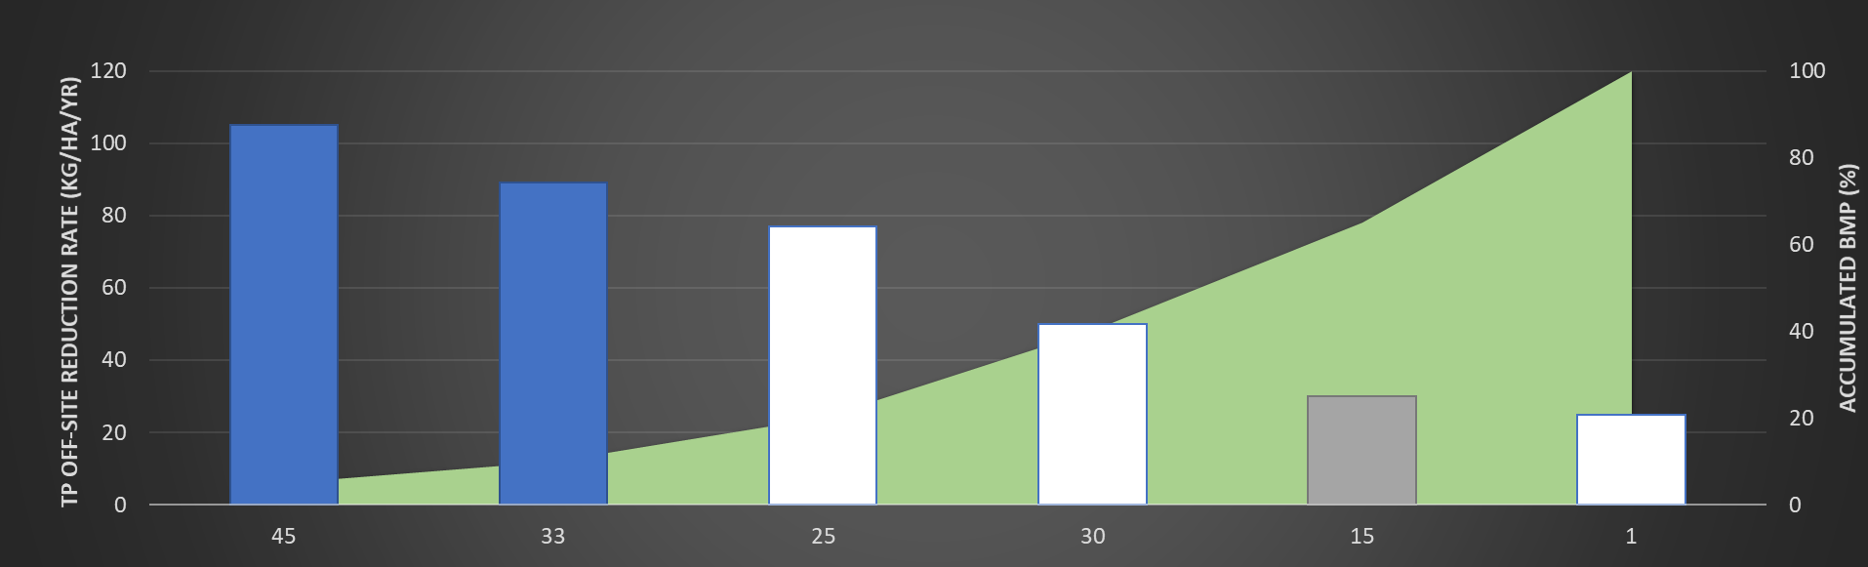
Logo
University of Guelph ESAT
Project name
shawn-uog@email.ca (manager)
UNIVERSITY OF GUELPH
Legend
Map | Satellite
Location filter ^{(?)}
Baseline information
 | Watershed
 | Stream
 | LSD or Parcel BMP type 1
Municipality
BMP scope & intelligent recommendation
Subwatershed
BMP Type 1
All
Clear
BMP Type 2
Intelligent setting ^{(?)}
BMP Type 3
Budget
BMP selection & overview
Budget ^{(?)}
Budget ^{(?)}
Budget ($)
20000
N
+
−
Cost and Effectiveness ^{(?)}
TP
Table | Chart
Off-site effectiveness
There are two level of drop list to define ranking chart
Run Intelligent Recommendation ^{(?)}
Notes:
BMP scope & intelligent recommendation – chart view option

Slide 31
Logo
University of Guelph ESAT
Project name
shawn-uog@email.ca (manager)
UNIVERSITY OF GUELPH
Legend
Map | Satellite
Location filter ^{(?)}
Baseline information
 | Watershed
 | Stream
 | LSD or Parcel BMP type 1
Municipality
BMP scope & intelligent recommendation
Subwatershed
BMP Type 1
All
Clear
BMP Type 2
Intelligent setting ^{(?)}
BMP Type 3
Budget
BMP selection & overview
Budget ^{(?)}
Budget ^{(?)}
Budget ($)
20000
N
+
−
Chart will indicate which location is selected, which is included in baseline, and the unselected locations
Cost and Effectiveness ^{(?)}
TP
Table | Chart
Off-site effectiveness
Run Intelligent Recommendation ^{(?)}
Notes:
Budget mode

Slide 32
Logo
University of Guelph ESAT
Project name
shawn-uog@email.ca (manager)
UNIVERSITY OF GUELPH
Legend
Map | Satellite
Location filter ^{(?)}
Baseline information
 | Watershed
 | Stream
 | LSD or Parcel BMP type 1
Municipality
BMP scope & intelligent recommendation
Subwatershed
BMP Type 1
All
Clear
BMP Type 2
Intelligent setting ^{(?)}
BMP Type 3
Eco-service
BMP selection & overview
Budget
Customize weight
Eco-service
Add constraint
# | Type | Value
1 | TP on-site | -15%
2 | Carbon | +10%
3 | Sediment off-site | -20%
..
+
−
Cost and Effectiveness ^{(?)}
TP
Table | Chart
Select | LSD or Parcel | Farm | BMP area (ha) | On-site effectiveness (kg/ha/yr) | Off-site effectiveness (kg/ha/yr) | Cost ($) | On-site cost-effectiveness | Off-site cost-effectiveness
 | 1
 | 11
 | 2
 | 7
 | 9
 | …
Run Intelligent Recommendation ^{(?)}
Notes:
Eco-service mode

Slide 33
Logo
University of Guelph ESAT
Project name
shawn-uog@email.ca (manager)
UNIVERSITY OF GUELPH
Legend
Map | Satellite
Location filter ^{(?)}
Baseline information
 | Watershed
 | Stream
 | LSD or Parcel BMP type 1
Municipality
BMP scope & intelligent recommendation
Subwatershed
BMP Type 1
All
Clear
BMP Type 2
Intelligent setting ^{(?)}
BMP Type 3
Eco-service
BMP selection & overview
Customize weight
+ Add constraint
# | Type | Value
1 | TP on-site | -15%
2 | Carbon | +10%
3 | Sediment off-site | -20%
..
+
−
Cost and Effectiveness ^{(?)}
TP
Table | Chart
Select | LSD or Parcel | Farm | BMP area (ha) | On-site effectiveness (kg/ha/yr) | Off-site effectiveness (kg/ha/yr) | Cost ($) | On-site cost-effectiveness | Off-site cost-effectiveness
 | 1
 | 11
 | 2
 | 7
 | 9
 | …
Run Intelligent Recommendation ^{(?)}
Notes:
Eco-service mode

Slide 34
Logo
University of Guelph ESAT
Project name
shawn-uog@email.ca (manager)
UNIVERSITY OF GUELPH
Legend
Map | Satellite
Location filter ^{(?)}
 | Watershed
 | Stream
 | LSD or Parcel BMP type 1
Eco-service Weight
Baseline information
X
Municipality
TP off-site | 30
Carbon | 20
Flood mitigation | 10
… | …
BMP scope & intelligent recommendation
Subwatershed
BMP Type 1
All
Clear
BMP Type 2
Intelligent setting ^{(?)}
BMP Type 3
Eco-service
BMP selection & overview
Customize weight
+ Add constraint
# | Type | Value
1 | TP on-site | -15%
2 | Carbon | +10%
3 | Sediment off-site | -20%
..
+
−
OK
Cancel
When click “Customize weight“ button, user can specify Eco-service Weight in different service type.
When click OK, system will check and inform user all weights must add up to 100.
Cost and Effectiveness ^{(?)}
TP
Table | Chart
Select | LSD or Parcel | Farm | BMP area (ha) | On-site effectiveness (kg/ha/yr) | Off-site effectiveness (kg/ha/yr) | Cost ($) | On-site cost-effectiveness | Off-site cost-effectiveness
 | 1
 | 11
 | 2
 | 7
 | 9
 | …
Run Intelligent Recommendation ^{(?)}
Notes:
Eco-service mode

Slide 35
Logo
University of Guelph ESAT
Project name
shawn-uog@email.ca (manager)
UNIVERSITY OF GUELPH
Legend
Map | Satellite
Location filter ^{(?)}
Baseline information
 | Watershed
 | Stream
 | LSD or Parcel BMP type 1
Municipality
BMP scope & intelligent recommendation
Subwatershed
BMP Type 1
All
Clear
BMP Type 2
X
Intelligent setting ^{(?)}
Add constraint
BMP Type 3
Eco-service
Constraint ^{(?)}
Type drop list
BMP selection & overview
Customize weight
Target ^{(?)}
-35%
%
+ Add constraint
Add
Cancel
# | Type | Value
1 | TP on-site | -15%
2 | Carbon | +10%
3 | Sediment off-site | -20%
..
When click “+ Add constraint“ button, user can add a constraint type and value to the table.
+
−
Cost and Effectiveness ^{(?)}
TP
Table | Chart
Select | LSD or Parcel | Farm | BMP area (ha) | On-site effectiveness (kg/ha/yr) | Off-site effectiveness (kg/ha/yr) | Cost ($) | On-site cost-effectiveness | Off-site cost-effectiveness
 | 1
 | 11
 | 2
 | 7
 | 9
 | …
Run Intelligent Recommendation ^{(?)}
Notes:
Eco-service mode

Slide 36
Logo
University of Guelph ESAT
Project name
shawn-uog@email.ca (manager)
UNIVERSITY OF GUELPH
Legend
Map | Satellite
Location filter ^{(?)}
Baseline information
 | Watershed
 | Stream
 | LSD or Parcel BMP type 2
Municipality
BMP scope & intelligent recommendation
Subwatershed
BMP Type 1
All
Clear
BMP Type 2
Intelligent setting ^{(?)}
BMP Type 3
Eco-service
BMP selection & overview
Customize weight
+ Add constraint
# | Type | Value
1 | TP on-site | -15%
2 | Carbon | +10%
3 | Sediment off-site | -20%
..
+
−
Cost and Effectiveness ^{(?)}
TP
Table | Chart
Select | LSD or Parcel | Farm | BMP area (ha) | On-site effectiveness (kg/ha/yr) | Off-site effectiveness (kg/ha/yr) | Cost ($) | On-site cost-effectiveness | Off-site cost-effectiveness
 | 1
 | 2
 | 3
 | 7
 | 9
 | …
After run Intelligent Recommendation, system will recommend BMP locations
Then the system will automatic jump to BMP selection & overview page in next slide
Run Intelligent Recommendation ^{(?)}
Notes:
BMP scope & intelligent recommendation on BMP type 2

Slide 37
Logo
University of Guelph ESAT
Project name
shawn-uog@email.ca (manager)
UNIVERSITY OF GUELPH
BMP selection & overview tool summarizes selected BMP(s) in each LSD or Parcel and their cost(s) and effectiveness
Legend
Map | Satellite
BMP summary ^{(?)}
Baseline information
BMP Layers
BMP | Count | Area (ha) | Cost ($/ha)
Cover crop | 132
Wetland | 15
…
Total cost ($/yr) | 3,840
 | BMP type 1
 | BMP type 2
 | BMP type 3
 | …
BMP scope & intelligent recommendation
When click on “BMP selection & overview”, show introduction pop-up (this page) of BMP selection & overview
User can also directly start from this tool without running BMP scope & intelligent recommendation tool
BMP selection & overview
BMP Type 1
BMP Type 2
Dismiss
Never show again
BMP Type 3
N
+
−
Effectiveness summary^{(?)}
Effectiveness | Value
Total P off-site (kg/yr) | -3,521
Carbon (ton/yr) | 151
Flood mitigation
Soil water
…
LSD or Parcel | Farm | LSD or Parcel BMP | Structural BMP | Cost ($)
3 |  | BMP type 1 (0.78 ha), BMP type 2 (1.55 ha) | None | 850
4 |  | BMP type 1 (3.45 ha) | BMP type 3 (0.03 ha) | 1,260
7 |  | BMP type 1 (2.89 ha, baseline) | None | 0
…
Report ^{(?)}
Notes:
User can also start from overview page and manual apply BMP

Slide 38
Logo
University of Guelph ESAT
Project name
shawn-uog@email.ca (manager)
UNIVERSITY OF GUELPH
Legend
Map | Satellite
BMP summary ^{(?)}
Baseline information
 | Watershed
 | Stream
 | LSD or Parcel BMP type 1 BMP type 2 Multiple BMP
 | BMP type 3 Selected
 | …
BMP | Count | Area (ha) | Cost ($/ha)
BMP type 1 | 15 | 132 | 3,566
BMP type 3 | 3 | 15 | 8,615
…
Total cost ($/yr) | 23,546
BMP scope & intelligent recommendation
M
BMP selection & overview
M
BMP Type 1
BMP Type 2
Overview map will show location for all BMP type
When 2 or more field BMPs are applied to same LSD or parcel, use multiple BMP symbol
BMP Type 3
N
M
+
−
Effectiveness summary^{(?)}
Effectiveness | Value
Total P off-site (kg/yr) | -3,521
Carbon (ton/yr) | 151
Flood mitigation
Soil water
…
Table summarize BMP in each LSD or parcel
If multiple field BMPs applied, separate them using comma “,”
Summarize BMP affecting area in bracket
Identify baseline if this BMP is included in baseline condition
LSD or Parcel | Farm | LSD or Parcel BMP | Structural BMP | Cost ($)
3 |  | BMP type 1 (0.78 ha), BMP type 2 (1.55 ha) | None | 850
4 |  | BMP type 1 (3.45 ha) | BMP type 3 (0.03 ha) | 1,260
7 |  | BMP type 1 (2.89 ha, baseline) | None | 0
…
Report button will generate a PDF or Word report for user to download
Report ^{(?)}
Notes:
Overview page

Slide 39
Logo
University of Guelph ESAT
Project name
shawn-uog@email.ca (manager)
UNIVERSITY OF GUELPH
Legend
Map | Satellite
Location filter ^{(?)}
Baseline information
 | Watershed
 | Stream
 | LSD or Parcel BMP type 1
Municipality
BMP scope & intelligent recommendation
Subwatershed
All
Clear
BMP selection & overview
BMP summary ^{(?)}
BMP Type 1
BMP summary table summarize all BMPs applied in the watershed
Count – LSD or Parcel, or structure BMP count
Area – BMP affected area
Cost – Total cost of this BMP type
BMP | Count | Area (ha) | Cost ($/ha)
BMP type 1 | 15 | 132 | 3,566
BMP type 3 | 3 | 15 | 8,615
…
Total cost ($/yr) | 23,546
BMP Type 2
BMP Type 3
Effectiveness summary table summarize all BMPs effectiveness in the watershed
Effectiveness – Effectiveness type with unit in bracket
Value – Effectiveness value
+
−
Cost and Effectiveness ^{(?)}
TP
Effectiveness summary^{(?)}
Table | Chart
Effectiveness | Value
Total P off-site (kg/yr) | -3,521
Carbon (ton/yr) | 151
Flood mitigation
Soil water
…
Select | LSD or Parcel | Farm | BMP area (ha) | On-site effectiveness (kg/ha/yr) | Off-site effectiveness (kg/ha/yr) | Cost ($) | On-site cost-effectiveness | Off-site cost-effectiveness
 | 1
 | 11
 | 2
 | 7
 | 9
 | …
Export button will export current BMP location in a shapefile, BMP effectiveness and costs will be saved in the attribute table
Export ^{(?)}
Notes:
Manually selection or reviewing intelligent selection of BMP type 1 in table view

Slide 40
Logo
University of Guelph ESAT
Project name
shawn-uog@email.ca (manager)
UNIVERSITY OF GUELPH
Legend
Map | Satellite
Location filter ^{(?)}
Baseline information
 | Watershed
 | Stream
 | LSD or Parcel BMP type 1
Municipality
BMP scope & intelligent recommendation
Subwatershed
All
Clear
BMP selection & overview
BMP summary ^{(?)}
BMP Type 1
BMP | Count | Area (ha) | Cost ($/ha)
BMP type 1 | 15 | 132 | 3,566
BMP type 3 | 3 | 15 | 8,615
…
Total cost ($/yr) | 23,546
BMP Type 2
BMP Type 3
N
+
−
Manual BMP selection tool also support chart and table view with same control mechanism as Intelligent recommendation tool
Cost and Effectiveness ^{(?)}
TP
Effectiveness summary^{(?)}
Table | Chart
Off-site effectiveness
Effectiveness | Value
Total P off-site (kg/yr) | -3,521
Carbon (ton/yr) | 151
Flood mitigation
Soil water
…
Export ^{(?)}
Notes:
Manually selection or reviewing intelligent selection of BMP type 1 in chart view

Slide 41
Logo
University of Guelph ESAT
Project name
shawn-uog@email.ca (manager)
UNIVERSITY OF GUELPH
Legend
Map | Satellite
Location filter ^{(?)}
Baseline information
Municipality
BMP scope & intelligent recommendation
Subwatershed
All
Clear
BMP selection & overview
BMP summary ^{(?)}
BMP Type 1
You are about to change the recommended BMPs.
Are you sure?
BMP | Count | Area (ha) | Cost ($/ha)
BMP type 1 | 15 | 132 | 3,566
BMP type 3 | 3 | 15 | 8,615
…
Total cost ($/yr) | 23,546
BMP Type 2
BMP Type 3
N
+
−
Cancel
Confirm
Never show again
Cost and Effectiveness ^{(?)}
TP
Effectiveness summary^{(?)}
Table | Chart
Off-site effectiveness
Effectiveness | Value
Total P off-site (kg/yr) | -3,521
Carbon (ton/yr) | 151
Flood mitigation
Soil water
…
Export ^{(?)}
Notes:
Warning if user is going to change Intelligent recommended BMPs.

Slide 42
Logo
University of Guelph ESAT
Project name
shawn-uog@email.ca (manager)
UNIVERSITY OF GUELPH
Legend
Map | Satellite
Location filter ^{(?)}
Baseline information
 | Watershed
 | Stream
 | LSD or Parcel BMP type 2
Municipality
BMP scope & intelligent recommendation
Subwatershed
All
Clear
BMP selection & overview
BMP summary ^{(?)}
BMP Type 1
BMP | Count | Area (ha) | Cost ($/ha)
BMP type 1 | 15 | 132 | 3,566
BMP type 3 | 3 | 15 | 8,615
…
Total cost ($/yr) | 23,546
BMP Type 2
BMP Type 3
+
−
Cost and Effectiveness ^{(?)}
TP
Effectiveness summary^{(?)}
Table | Chart
Effectiveness | Value
Total P off-site (kg/yr) | -3,521
Carbon (ton/yr) | 151
Flood mitigation
Soil water
…
Select | LSD or Parcel | Farm | BMP area (ha) | On-site effectiveness (kg/ha/yr) | Off-site effectiveness (kg/ha/yr) | Cost ($) | On-site cost-effectiveness | Off-site cost-effectiveness
 | 1
 | 2
 | 3
 | 7
 | 9
 | …
Export ^{(?)}
Notes:
Manually selection or reviewing intelligent selection of BMP type 2 in table view

Slide 43
Logo
University of Guelph ESAT
Project name
shawn-uog@email.ca (manager)
UNIVERSITY OF GUELPH
Legend
Map | Satellite
Location filter ^{(?)}
Baseline information
 | Watershed
 | Stream
 | BMP type 3 Selected
Municipality
BMP scope & intelligent recommendation
Subwatershed
All
Clear
BMP selection & overview
BMP summary ^{(?)}
BMP Type 1
BMP | Count | Area (ha) | Cost ($/ha)
BMP type 1 | 15 | 132 | 3,566
BMP type 3 | 3 | 15 | 8,615
…
Total cost ($/yr) | 23,546
BMP Type 2
BMP Type 3
+
−
Cost and Effectiveness ^{(?)}
TP
Effectiveness summary^{(?)}
Table | Chart
Effectiveness | Value
Total P off-site (kg/yr) | -3,521
Carbon (ton/yr) | 151
Flood mitigation
Soil water
…
Select | BMP type 3 | Farm | BMP area (ha) | On-site effectiveness (kg/ha/yr) | Off-site effectiveness (kg/ha/yr) | Cost ($) | On-site cost-effectiveness | Off-site cost-effectiveness
 | 1
 | 11
 | 2
 | 7
 | 9
 | …
Export ^{(?)}
Notes:
Manually selection or reviewing intelligent selection of BMP type 3 in table view

Slide 44
Producer user version

Slide 45
Logo
Overview
shawn-uog@email.ca (producer)
UNIVERSITY OF GUELPH
University of Guelph ESAT
Project
Legend
Map | Satellite
 | Watershed
 | Stream
N
+
−
Parcel | Farm | Area (ha) | Elevation (m) | Slope (%) | Dominant land use | Dominant soil texture | Runoff (mm/yr) | Runoff std (mm/yr) | TSS (ton/yr) | TSS std (ton/yr) | …
1
2
3
…
Notes:
Watershed result display
System supports different level display, LSD or Parcel, municipality, or watershed

Slide 46
Logo
Overview
Project
shawn-uog@email.ca (producer)
UNIVERSITY OF GUELPH
University of Guelph ESAT
Add or Open project ^{(?)}
+
Add Project
Date | Title
2019-07-05 | Farm TP
2019-06-21 | Farm TP on-site
2019-06-20 | Farm cost minimum
2019-05-15 | Farm carbon
2018-02-11 | Farm drought
…
TP On-site Effectiveness (kg/yr)
Notes:
Farmer project management page

Slide 47
Logo
Overview
Project
shawn-uog@email.ca (producer)
UNIVERSITY OF GUELPH
University of Guelph ESAT
Add or Open project ^{(?)}
+
Add Project
Date | Title
2019-07-05 | Farm TP
2019-06-21 | Farm TP on-site
2019-06-20 | Farm cost minimum
2019-05-15 | Farm carbon
2018-02-11 | Farm drought
…
Add new project
X
Title
Test project
Description
This is a test project created by Shawn
BMP Scale ^{(?)}
Field BMP scale drop list
Add
Cancel
TP On-site Effectiveness (kg/yr)
Notes:
Farmer project management page

Slide 48
Logo
University of Guelph ESAT
Project name
shawn-uog@email.ca (producer)
UNIVERSITY OF GUELPH
Legend
Map | Satellite
Existing BMP summary^{(?)}
Ray’s farm
 | Watershed
 | Stream
 | LSD or Parcel
BMP | Count | Area (ha) | Cost ($/ha)
BMP type 1 | 15 | 132 | 3,566
BMP type 3 | 3 | 15 | 8,615
…
Total cost ($/yr) | 23,546
BMP selection & overview
Only manual BMP selection is supported for farmer user
N
+
−
Farm summary^{(?)}
Effectiveness | Value
Total P off-site (kg/yr) | -3,521
Carbon (ton/yr) | 151
Flood mitigation
Soil water
…
LSD or Parcel | Farm | Area (ha) | Elevation (m) | Slope (%) | Dominant land use | Dominant soil texture | Runoff (mm/yr) | Runoff std (mm/yr) | TSS (ton/yr) | TSS std (ton/yr) | …
1
2
3
…
Notes:
Farm view page

Slide 49
Logo
University of Guelph ESAT
Project name
shawn-uog@email.ca (producer)
UNIVERSITY OF GUELPH
Legend
Map | Satellite
Select BMP
Ray’s farm
 | Watershed
 | Stream
 | LSD or Parcel BMP type 1
All
Clear
BMP selection & overview
BMP summary ^{(?)}
BMP | Count | Area (ha) | Cost ($/ha)
BMP type 1 | 15 | 132 | 3,566
BMP type 3 | 3 | 15 | 8,615
…
Total cost ($/yr) | 23,546
BMP Type 1
BMP Type 2
Except the visibility of geographical scope
Farmer and manager Manual BMP selection tool is identical.
BMP Type 3
+
−
Effectiveness summary^{(?)}
Effectiveness | Value
Total P off-site (kg/yr) | -3,521
Carbon (ton/yr) | 151
Flood mitigation
Soil water
…
Cost and Effectiveness ^{(?)}
TP
Table | Chart
Select | LSD or Parcel | Farm | BMP area (ha) | On-site effectiveness (kg/ha/yr) | Off-site effectiveness (kg/ha/yr) | Cost ($) | On-site cost-effectiveness | Off-site cost-effectiveness
 | 1
 | 11
 | 2
 | 7
 | 9
 | …
Export ^{(?)}
Notes:
Manual BMP selection type 1

Slide 50
Logo
University of Guelph ESAT
Project name
shawn-uog@email.ca (producer)
UNIVERSITY OF GUELPH
Legend
Map | Satellite
Select BMP
Ray’s farm
 | Watershed
 | Stream
 | LSD or Parcel BMP type 1
All
Clear
BMP selection & overview
BMP summary ^{(?)}
BMP | Count | Area (ha) | Cost ($/ha)
BMP type 1 | 15 | 132 | 3,566
BMP type 3 | 3 | 15 | 8,615
…
Total cost ($/yr) | 23,546
BMP Type 1
BMP Type 2
BMP Type 3
N
+
−
Effectiveness summary^{(?)}
Effectiveness | Value
Total P off-site (kg/yr) | -3,521
Carbon (ton/yr) | 151
Flood mitigation
Soil water
…
Cost and Effectiveness ^{(?)}
TP
Table | Chart
Off-site effectiveness
Export ^{(?)}
Notes:
Manual BMP selection type 1

Slide 51
Logo
University of Guelph ESAT
Project name
shawn-uog@email.ca (producer)
UNIVERSITY OF GUELPH
Legend
Map | Satellite
Select BMP
Ray’s farm
 | Watershed
 | Stream
 | LSD or Parcel BMP type 2
All
Clear
BMP selection & overview
BMP summary ^{(?)}
BMP | Count | Area (ha) | Cost ($/ha)
BMP type 1 | 15 | 132 | 3,566
BMP type 3 | 3 | 15 | 8,615
…
Total cost ($/yr) | 23,546
BMP Type 1
BMP Type 2
BMP Type 3
+
−
Effectiveness summary^{(?)}
Effectiveness | Value
Total P off-site (kg/yr) | -3,521
Carbon (ton/yr) | 151
Flood mitigation
Soil water
…
Cost and Effectiveness ^{(?)}
TP
Table | Chart
Select | LSD or Parcel | Farm | BMP area (ha) | On-site effectiveness (kg/ha/yr) | Off-site effectiveness (kg/ha/yr) | Cost ($) | On-site cost-effectiveness | Off-site cost-effectiveness
 | 1
 | 2
 | 3
 | 7
 | …
Export ^{(?)}
Notes:
Manual BMP selection type 2

Slide 52
Logo
University of Guelph ESAT
Project name
shawn-uog@email.ca (producer)
UNIVERSITY OF GUELPH
Legend
Map | Satellite
Select BMP
Ray’s farm
 | Watershed
 | Stream
 | BMP type 3 Selected
All
Clear
BMP selection & overview
BMP summary ^{(?)}
BMP | Count | Area (ha) | Cost ($/ha)
BMP type 1 | 15 | 132 | 3,566
BMP type 3 | 3 | 15 | 8,615
…
Total cost ($/yr) | 23,546
BMP Type 1
BMP Type 2
BMP Type 3
+
−
Effectiveness summary^{(?)}
Effectiveness | Value
Total P off-site (kg/yr) | -3,521
Carbon (ton/yr) | 151
Flood mitigation
Soil water
…
Cost and Effectiveness ^{(?)}
Option
TP
Table | Chart
Select | BMP type 3 | Farm | BMP area (ha) | On-site effectiveness (kg/ha/yr) | Off-site effectiveness (kg/ha/yr) | Cost ($) | On-site cost-effectiveness | Off-site cost-effectiveness
 | 11
 | 2
Export ^{(?)}
Notes:
Manual BMP selection type 3

Slide 53
Logo
University of Guelph ESAT
Project name
shawn-uog@email.ca (producer)
UNIVERSITY OF GUELPH
Legend
Map | Satellite
BMP summary ^{(?)}
Ray’s farm
 | Watershed
 | Stream
 | LSD or Parcel BMP type 1 BMP type 2 Multiple BMP
 | BMP type 3 Selected
 | …
BMP | Count | Area (ha) | Cost ($/ha)
BMP type 1 | 15 | 132 | 3,566
BMP type 3 | 3 | 15 | 8,615
…
Total cost ($/yr) | 23,546
BMP selection & overview
BMP Type 1
BMP Type 2
M
BMP Type 3
N
M
+
−
Effectiveness summary^{(?)}
Effectiveness | Value
Total P off-site (kg/yr) | -3,521
Carbon (ton/yr) | 151
Flood mitigation
Soil water
…
LSD or Parcel | Farm | LSD or Parcel BMP | Structural BMP | Cost ($)
1 |  | BMP type 1, BMP type 2 | None | 850
2 |  | BMP type 1 | BMP type 3 | 1,260
3 |  | BMP type 1 (baseline) | None | 0
…
Report ^{(?)}
Notes:
Overview page

Slide 54
End of design

